Slide 1

SMART ATTENDANCE PROJECT
PROJECT PROPOSAL

Slide 2



My team
STUdeNT
RObINSON e. aNTHONY
MeNTOR
JOVIN KaMaLa

Slide 3




TABLE OF CONTENT
Problem
Key terms
data Collection
Objectives
Related Works
data analysis
Scope
Proposed Project
Methodologies
3

Slide 4


What is the problem ?
The current system is
manual attendance
system
Where the use of sheet
of paper is more
preferred
4

Slide 5





objectives
TO DEVELOP MOBILE APP
AND WEB BASED SYSTEM
Check the location of the
students and Save students
credential for automation.
The objective of this project is to Design and Develop automated student location based time and attendance tracking system
Capture students current
Location In specific period
5

Slide 6


scope
The system will be
developed to operate
on smartphones and
web browsers.
6

Slide 7




Key terms
7

Slide 8




Related works
System Failure
Image Quality
Cost
It is Expensive
Storage
Range
Flexibility
Biased Information
Damages
Not ideal for remote
And field works
Angles
Less information
8

Slide 9


PROpOSed PROJeCT
The System is based on the use of location of the student and time of different session in the process of tracking student’s attendance.
9

Slide 10



PROpOSed PROJeCT
Features of Proposed System
Use of Beacons For
capturing attendance
Automated System
Mobile and Web Application
10

Slide 11


data collection
Observation is a data collection technique which entails use of senses to collect data from the internal environment.
An interview is a face-to-face conversation between two individuals with the sole purpose of collecting relevant information
to satisfy the proposed system
11

Slide 12

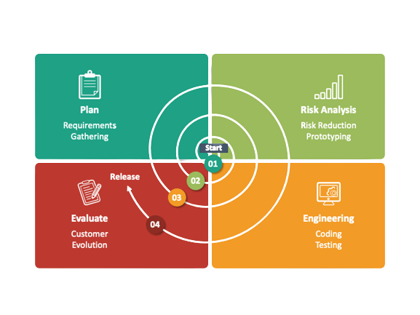
Methodology
Spiral Model
Is a systems development lifecycle (SDLC) method used for risk management that combines the iterative development process model with elements of the Waterfall model.
14

Slide 13

any Question Please!!!

Slide 14

PREPARED BY ROBINSON

